Slide 1
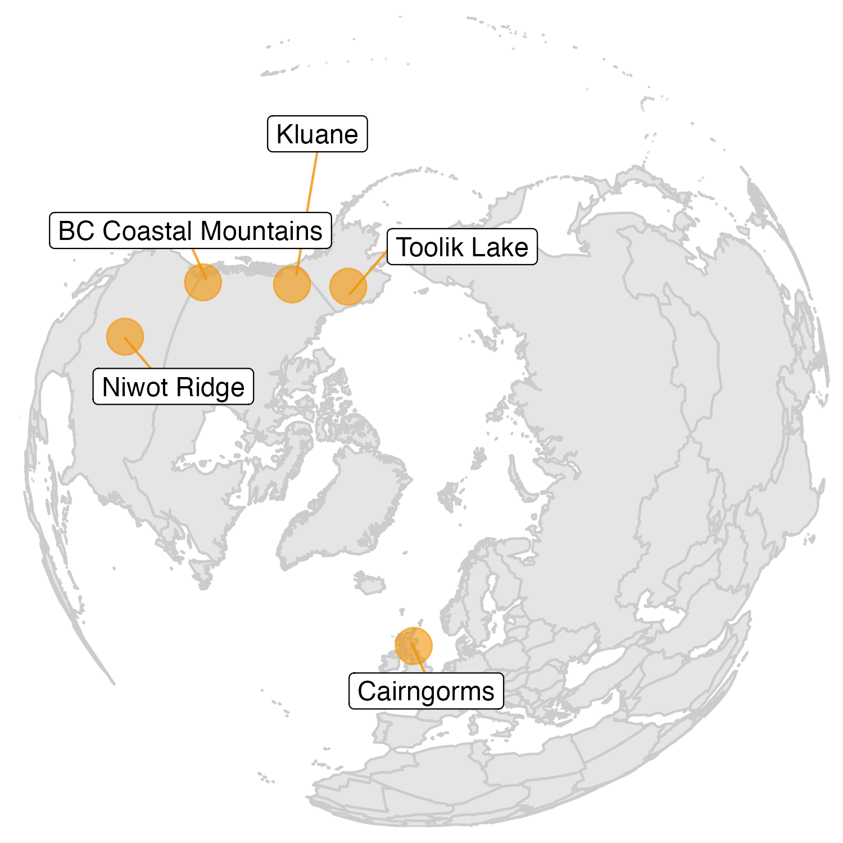
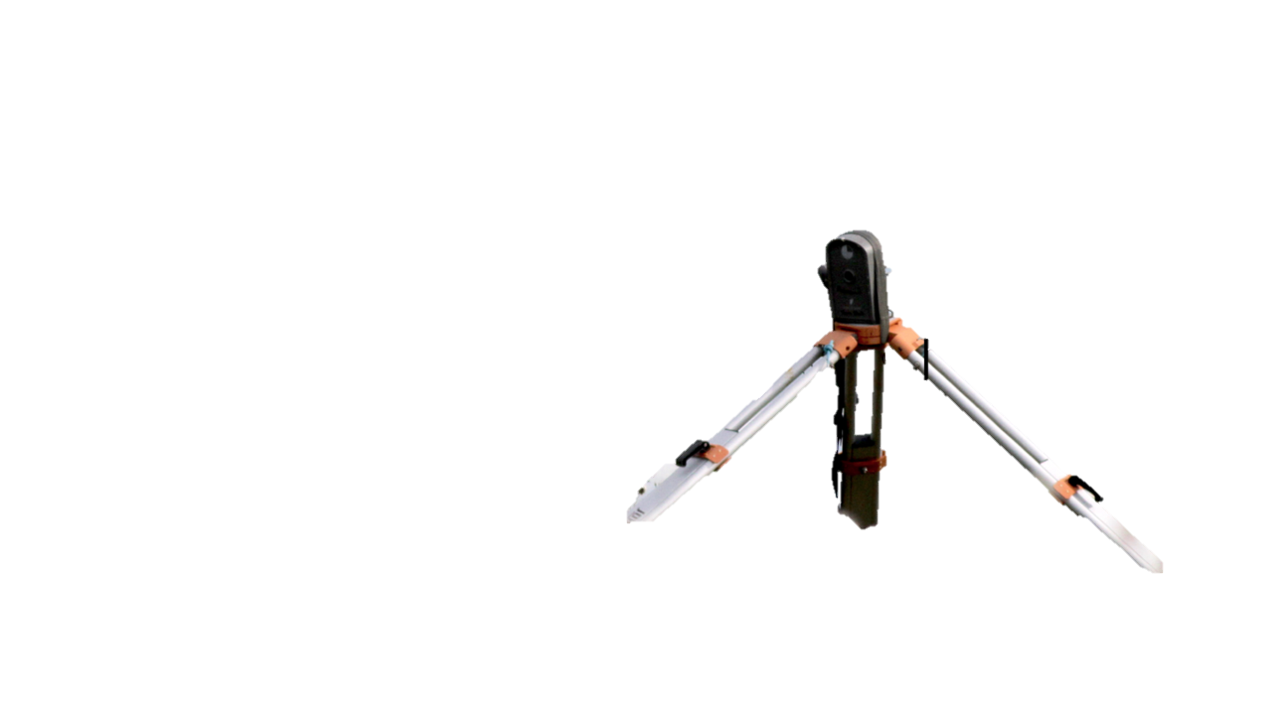
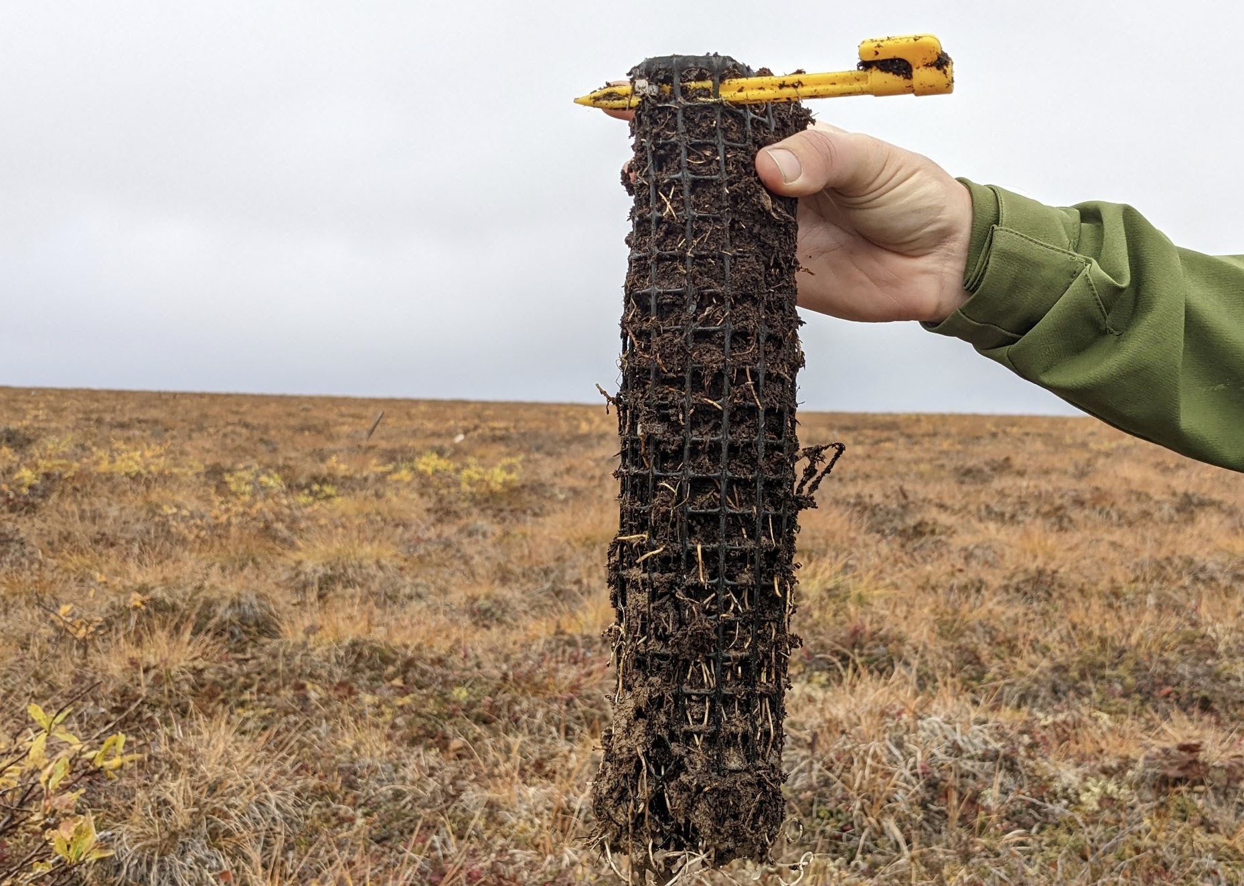
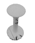
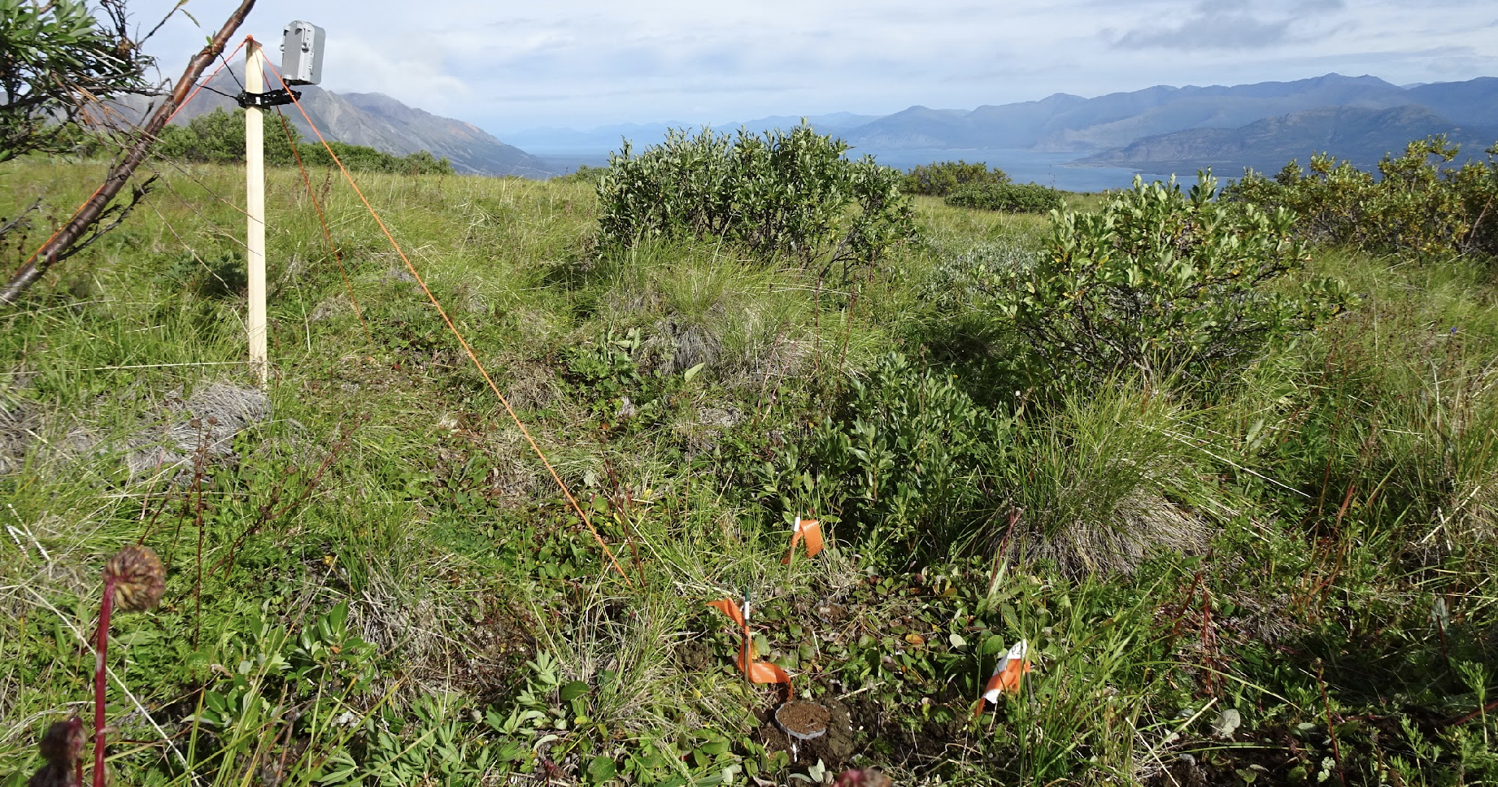
a)
b)
Phenocam Viewshed
c)
P1
P2
P3
~ 3 m²
Phenocam
1.5 m
In-growth cores and TOMST logger
P1
30cm
30cm
P2
P3
30cm
d)
Phenocam
P1
In-growth cores
P3
P2

